Slide 1

CSE4227 Digital Image Processing
_{Lecture 02 – Digital image}
_{Fundamentals}
Dr. Kazi A Kalpoma
Professor, Department of CSE
& Director of ICT
Ahsanullah University of Science & Technology (AUST)
Contact: kalpoma@aust.com
CSE | AUST
Fall 2021

Slide 2
Today’s Contents
Image Sensing and Acquisition
  Visual Perception
  Image Formation
  Image Acquisition
  Image formation model
Chapter 2 from R.C. Gonzalez and R.E. Woods, Digital Image Processing (3rd Edition), Prentice Hall, 2008 [ Section 2.1, 2.2, 2.3 ]

Slide 3
What is meant by visual perception?
Visual perception is the ability to see and interpret (analyze and give meaning to) the visual information that surrounds us.
There is a large difference between the image we display and the image we actually perceive.

Slide 4
Human Visual System
There is a difference between the luminance of a pixel on a computer screen and the perceived brightness of this pixel.
If we double the screen luminance, this does not imply that the perceived brightness is doubled too.
The brightness also depends on other factors, such as contrast around the pixel and various cognitive processes

Slide 5
Human Visual System
The human visual system can perform a number of image processing tasks in a manner vastly superior to anything we are presently able to do with computers.
The best vision model we have!
If we want to mimic such processing, we need to carefully study the way our eyes and brain do this.

Slide 6
Human Visual System
The human visual system consists of two functional parts:
  eye and
  (part of the) brain.
The brain does all of the complex image processing, while the eye functions as the biological equivalent of a camera.

Slide 7
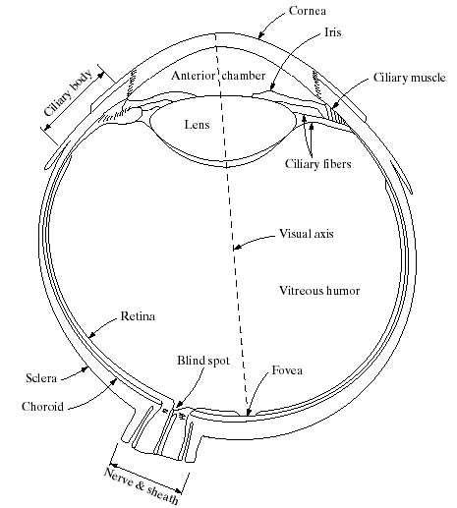
Structure Of The Human Eye
The lens focuses light from objects onto the retina
The retina is covered with
light receptors called
cones (6-7 million) and
rods (75-150 million)
Cones are concentrated
around the fovea and are
very sensitive to colour
Rods are more spread out
and are sensitive to low levels of illumination
Notes:
Cornea and sclera keep everything in!
The choroid contains all of the blood vessels that serve as nutrition to the eye
The iris contains the pigment that gives our eyes their colour
Rods for general vision cones for details
Blind spot is where the optic nerve connects
BLIND SPOT EXPERIMENT
Women have extra cones which means they can see more colours

Slide 8
When a light ray hits the eye, it will first pass through the cornea, then subsequently through the aqueous humor, the iris, the lens, and the vitreous humor before finally reaching the retina.
The cornea is a transparent protective layer, which acts as a lens and refracts the light.
The iris forms a round aperture that can vary in size and so determines the amount of light that can pass through.
In the retina, the light rays are detected and converted to electrical signals by photoreceptors.

Slide 9
Visual Perception: Human Eye
The lens contains 60-70% water, 6% of fat.
The iris diaphragm controls amount of light that enters the eye.
Light receptors in the retina are Cones and Rods:
- Cones for bright light vision called photopic
  - Cones involve in color vision.
  - Cones are concentrated in fovea about 1.5x1.5 mm².
  - Rods for dim light vision called scotopic
  - Rods are sensitive to low level of light and
  - are not involved in color vision.
Blind spot is the region of emergence of the optic nerve from the eye. In this area receptors are absent and no image detection.

Slide 10
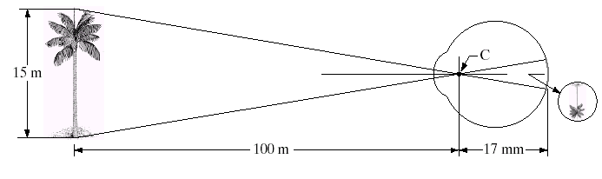
Image Formation In The Eye
Muscles within the eye can be used to change the shape of the lens allowing us focus on objects that are near or far away
An image is focused onto the retina causing rods and cones to become excited which ultimately send signals to the brain
(Height of the tree in the retinal image ) / 17 = (15/100 )

Slide 11

Some psychophysics:
Blind-Spot Experiment
Draw an image similar to that below on a piece of paper (the dot and cross are about 6 inches apart)
Close your right eye and focus on the cross with your left eye
Hold the image about 20 inches away from your face and move it slowly towards you
The dot should disappear!

Slide 12
Brightness Adaptation & Discrimination
The human visual system can perceive
approximately 10¹⁰ different light intensity levels
However, at any one time we can only discriminate between a much smaller number – brightness adaptation
Similarly, the perceived intensity of a region is related to the light intensities of the regions surrounding it

Slide 13
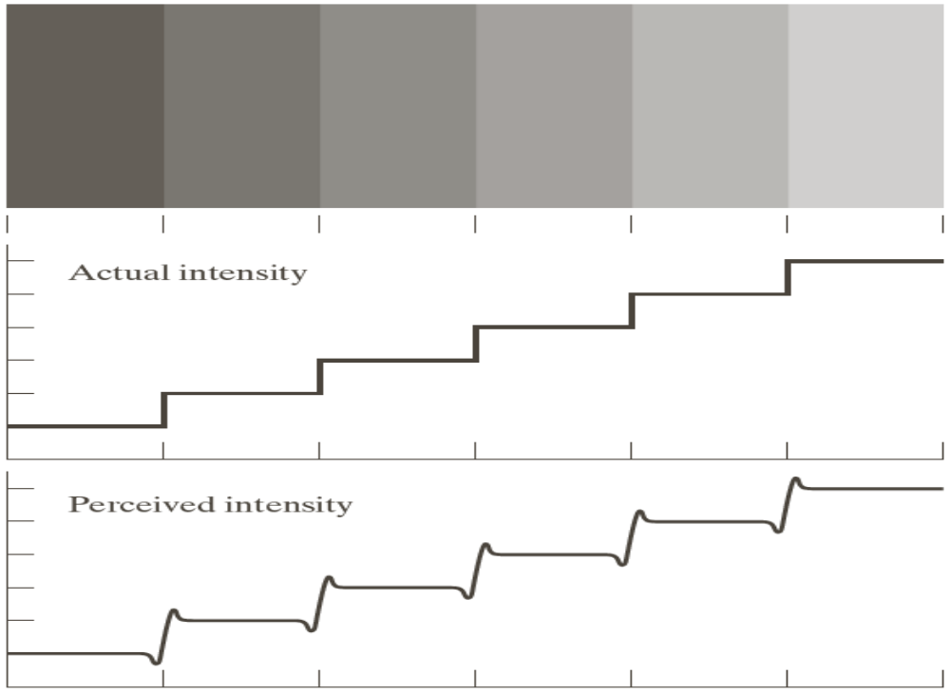
Brightness Adaptation & Discrimination
Intensities of surrounding points effect perceived brightness at each point.
In this image, edges between bars appear brighter on the right side and darker on the left side.
Notes:
Mach bands were named after Ernst Mach who described the phenomenon in 1865

Slide 14

Mach Band Effect (Cont)
A
B
Ernst Mach described this phenomenon in 1865
Intensity
Position
In area A, brightness perceived is darker while in area B is brighter.
This phenomenon is called Mach Band Effect.

Slide 15
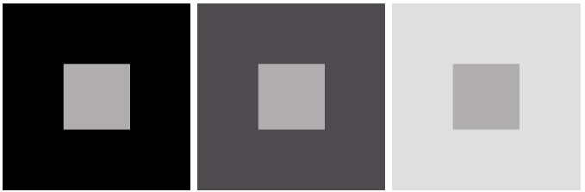
Brightness Adaptation & Discrimination (cont…)
An example of simultaneous contrast
Notes:
Mach bands were named after Ernst Mach who described the phenomenon in 1865

Slide 16

Optical Illusions
Stare at the cross in the middle of the image and think circles.

Slide 17


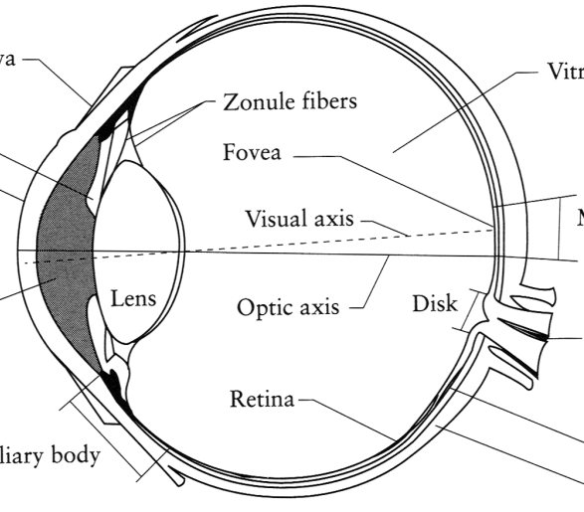
Image Formation
Digital Camera
Film
The Eye

Slide 18
_{IMAGE SENSING AND ACQUISITION}

Slide 19
In the following slides we will consider what is involved in capturing a digital image of a real-world scene
  Image sensing and representation and acquisition
  Sampling and quantisation
  Resolution

Slide 20

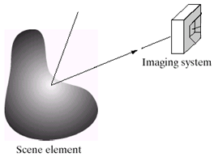
Image Acquisition
Three main elements
  Illumination source
  Scene
  Sensor (imaging system)

Slide 21
Image Acquisition
Illumination source:
  Can be light energy or
  EM spectrum
  Even less tradition sources like
    Sound, heat
Scene:
  Any object: visible or hidden
  Source itself
Sensor:
  Should be capable of sensing the energy

Slide 22
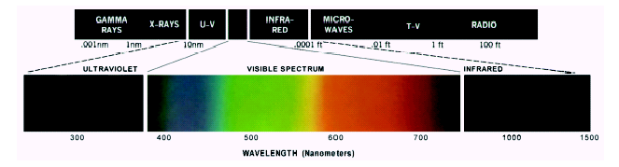
Light And The Electromagnetic Spectrum
In 1666 Sir Isaac Newton discovered that sunlight passed through a prism splits into a continuous spectrum of colors
Light is just a particular part of the electromagnetic spectrum that can be sensed by the human eye
The electromagnetic spectrum is split up according to the wavelengths of different forms of energy
Notes:
The electromagnetic spectrum is the entire range and scope (spectrum) of frequencies of electromagnetic radiation and their respective wavelengths and photon energies.

Slide 23
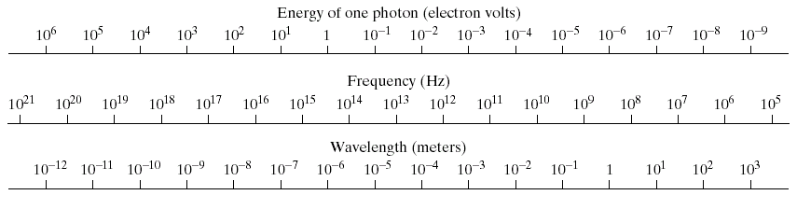
A discrete bundle (or quantum) of electromagnetic (or light) energy, PHOTON is proportional to frequency.
Notes:
The types of electromagnetic radiation are broadly classified into the following classes:^{[5]}
Gamma radiation
X-ray radiation
Ultraviolet radiation
Visible radiation
Infrared radiation
Terahertz radiation
Microwave radiation
Radio waves

Slide 24
A photon’s life choices
Absorption
Diffusion
Reflection
Transparency
Refraction
Fluorescence
Subsurface scattering
Phosphorescence
Interreflection
light source
λ
?
Chapter 2 of Szeliski

Slide 25
A photon’s life choices
Absorption
Diffusion
Reflection
Transparency
Refraction
Fluorescence
Subsurface scattering
Phosphorescence
Interreflection
light source
λ

Slide 26
A photon’s life choices
Absorption
Diffuse Reflection
Reflection
Transparency
Refraction
Fluorescence
Subsurface scattering
Phosphorescence
Interreflection
light source
λ

Slide 27
A photon’s life choices
Absorption
Diffusion
Specular Reflection
Transparency
Refraction
Fluorescence
Subsurface scattering
Phosphorescence
Interreflection
light source
λ

Slide 28
A photon’s life choices
Absorption
Diffusion
Reflection
Transparency
Refraction
Fluorescence
Subsurface scattering
Phosphorescence
Interreflection
light source
λ

Slide 29
A photon’s life choices
Absorption
Diffusion
Reflection
Transparency
Refraction
Fluorescence
Subsurface scattering
Phosphorescence
Interreflection
light source
λ

Slide 30
A photon’s life choices
Absorption
Diffusion
Reflection
Transparency
Refraction
Fluorescence
Subsurface scattering
Phosphorescence
Interreflection
light source
λ₁
λ₂

Slide 31
A photon’s life choices
Absorption
Diffusion
Reflection
Transparency
Refraction
Fluorescence
Subsurface scattering
Phosphorescence
Interreflection
light source
λ

Slide 32
A photon’s life choices
Absorption
Diffusion
Reflection
Transparency
Refraction
Fluorescence
Subsurface scattering
Phosphorescence
Interreflection
light source
t=1
t=n

Slide 33
A photon’s life choices
Absorption
Diffusion
Reflection
Transparency
Refraction
Fluorescence
Subsurface scattering
Phosphorescence
Interreflection
light source
λ
(Specular Interreflection)

Slide 34
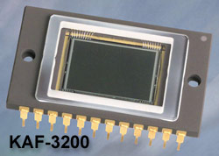
Image Sensors
Incoming energy lands on a sensor material responsive to that type of energy and this generates a voltage
Collections of sensors are arranged to capture images
Charge-Coupled Device (CCD)
 Used for convert a continuous
image into a digital image
 Contains an array of light sensors
 Converts photon into electric charges
accumulated in each sensor unit
CCD KAF-3200E from Kodak.
(2184 x 1472 pixels,
Pixel size 6.8 microns²)

Slide 35
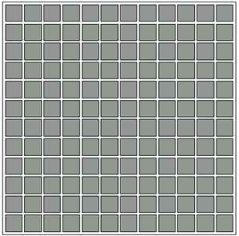
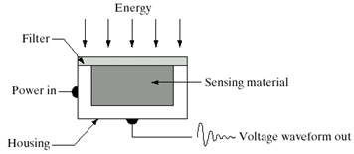
Image Sensors used to transform illumination energy to digital images.
3 main sensor arrangements:
    Single sensor
    Line sensor
    Array sensor
Single sensor
Array sensor
Line sensor
    Sensing element can be a photodiode
    Filter absorbs extra energy or acts as pass-band
Notes:
Incoming energy lands on a sensor material responsive to that type of energy and this generates a voltage
Collections of sensors are arranged to capture images

Slide 36
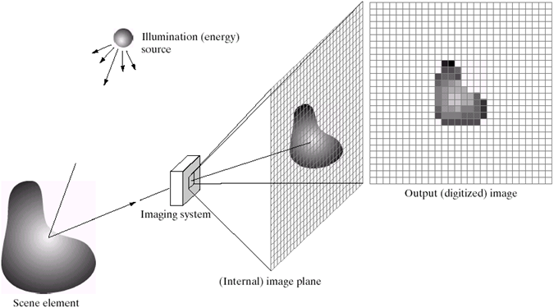
Image Acquisition using Sensor Array
Images are typically generated by illuminating a scene and absorbing the energy reflected by the objects in that scene.

Slide 37
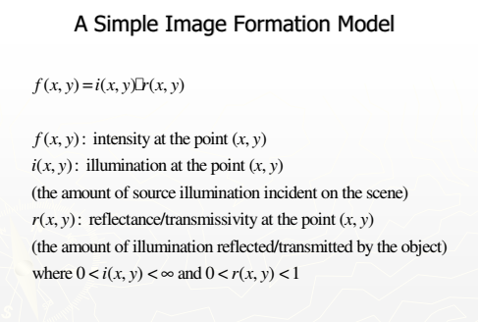

Slide 38
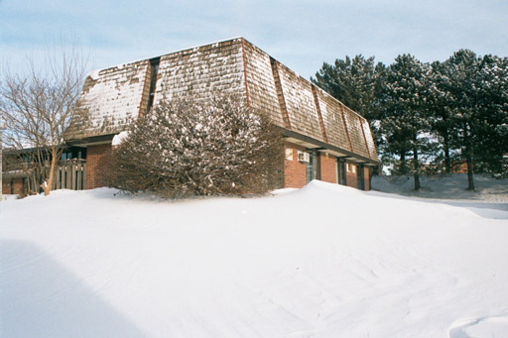

Image Formation Model
x
Origin
y
f(x,y)
Image “After snow storm”
An image: a multidimensional function of spatial coordinates.
Spatial coordinate: (x,y) for 2D case such as photograph,
(x,y,z) for 3D case such as CT scan images
(x,y,t) for movies
The function f may represent intensity (for monochrome images) or color (for color images) or other associated values.

Slide 39
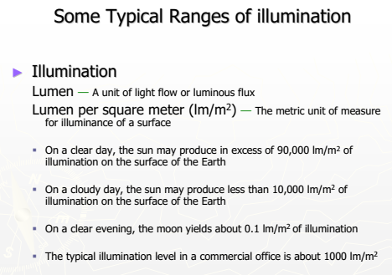

Slide 40
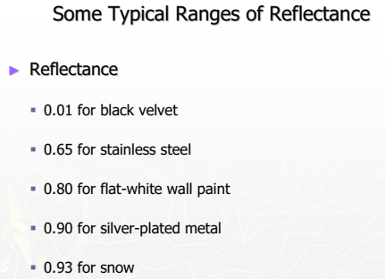

Slide 41
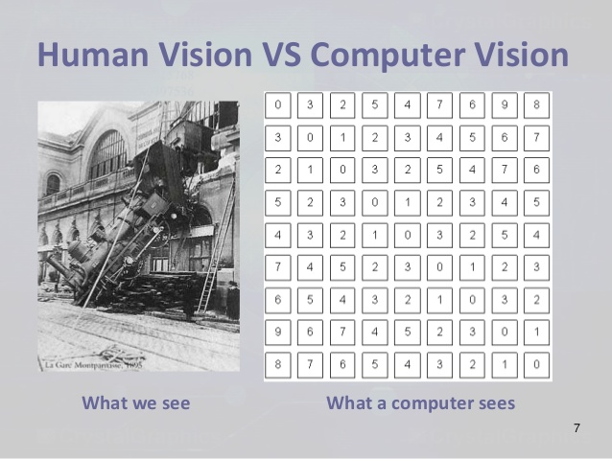

Slide 42












Image Digitization
Computers use discrete form of the pictures
The process transforming continuous analog image into discrete approximated image is called digitization.
Transforming Process
Analog image
Digital image
Two steps:
  Sampling and
  Quantization

Slide 43
Image Sampling And Quantisation
  Sampling:
    Digitizing coordinates
    A process which converts the continuous analog space into a discrete space
  Quantization:
    Digitizing amplitudes (gray scale values)
    A process of converting a continuous analogue signal into a digital representation of that signal

Slide 44

Image Quantisation
7
6
5
4
3
2
1
0
Digitizing the amplitude values
Notes:
Analogue Vs digital
Think of the volume knob on your stereo
Records Vs CDs Vs Mp3s
Nyquist theory etc talks about how much sampling we need to do

Slide 45
Image Sampling
Digitizing the coordinate values
Notes:
Analogue Vs digital
Think of the volume knob on your stereo
Records Vs CDs Vs Mp3s
Nyquist theory etc talks about how much sampling we need to do

Slide 46
Image Sampling And Quantisation
7
6
5
4
3
2
1
0
A
7 | 7 | 7 | 1 | 2 | 3 | 4 | 4 | 5 | 5 | 5 | 5 | 5 | 4 | 3 | 3 | 2 | 1 | 0 | 0 | 7 | 7 | 7
B
Notes:
Analogue Vs digital
Think of the volume knob on your stereo
Records Vs CDs Vs Mp3s
Nyquist theory etc talks about how much sampling we need to do

Slide 47
Image Sampling And Quantisation
Remember that a digital image is always only an approximation of a real world scene

Slide 48
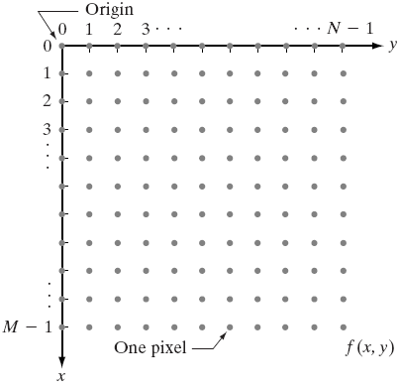
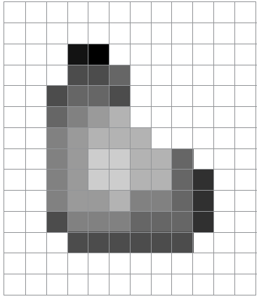
Representation of Digital Image
Matrix Representation

Slide 49
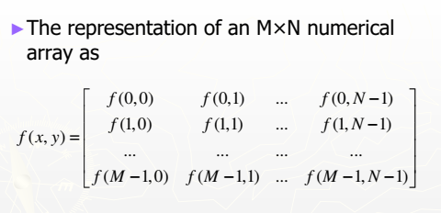
Representation of Digital Image

Slide 50
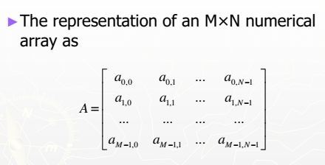
Representation of Digital Image
Traditional Matrix

Slide 51
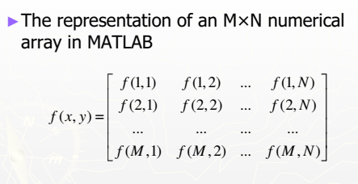
Representation of Digital Image

Slide 52
Next class >>>
  Resolutions
  Types of Digital Image
  Effect of Spatial and Gray Level Resolutions

